Slide 1
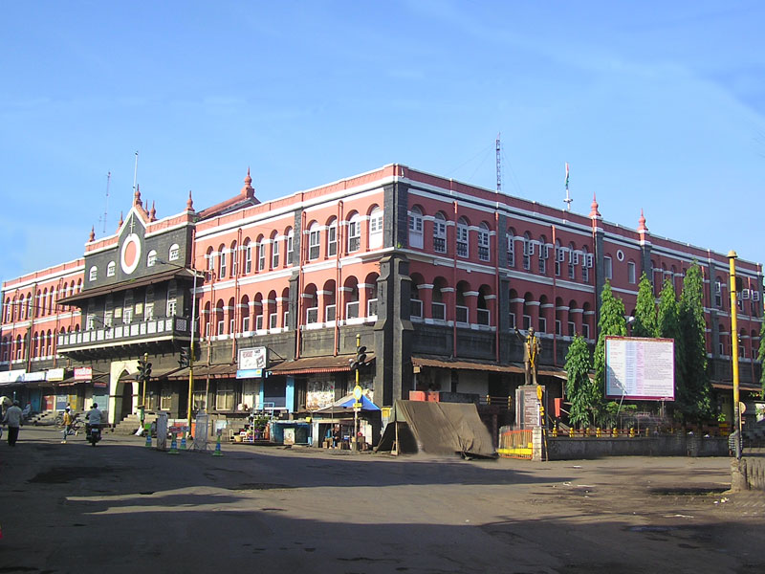
Municipal Corporation Management

Slide 2
Municipal Corporation Management
Project By :-
1.Sahil More.
2.Vaibhav Bhongale.
3.Shivkumar Patil.
4.Kunal Patil.

Slide 3
Abstract
This application provides an interface to register one’s complained and follow it up. It provide a camera module which help clicking up a picture of any problem that people are facing and upload its image along with the complaint. Regular attendance is also maintained of the workers in specific areas by their allotted admin and the report is submitted to the Super Admin. This report helps to study which area in particular is not prompt for their cleaning schedule. A proper feedback is taken by the users after their problems are resolved. These feedbacks helps to locate any flaws in the working and tackle them out.

Slide 4
Introduction
The proposed app is about Municipal Corporation Management System for Citizens and society for the city areas where the citizens face a vast amount of problems which are unknown to corporates of that particular area. The proposed app will help citizens in interacting with the corporation representative that is the corporater to solve their problems they face in their particular areas. They include the complaints like litter not managed properly, sewage waste not managed, roads problems, water related problems, electricity not available, and many other problems related to the area.
This app can also help public knowing their place details and getting their problems solved in online without going to the officer regularly until the problem is solved.by this system the public can save their time.

Slide 5
Study of Existing System
The existing system does not provide the facility to complaint directly. The complaints were not solved properly. The problems in the society were not resolved properly. The complaints from the citizens were sometimes not solved and the citizens have to face a lot of problems.
Citizens found it difficult to express their problems and the workers attending in the society. The workers present or not and doing work properly was unknown to corporators as well as the citizens. Thus there is a need of such provision that the citizens problems can be solved and also the corporators can interact with the citizens. Thus there is a need of user friendly app.

Slide 6
Need of proposed System
The proposed app helps citizens to solve the citizens day to day problems like Garbage collection, sewage management, roads cleaning, etc.
As also the citizen can interact with corporators to get solved their problems regularly.
Workers attendance provision provides whether the workers attend the work in the society properly or not.
The citizens can review their problems and get solved easily.
Thus this system provides user friendly interactions for the problems can be solved thoroughly.

Slide 7
Requirement Analysis
Super Admin is needed for the allocation and supervision of different area Admins.
Admins are kept for different areas to maintain the report of everyday.
User needs to file his/her complaint by logging in their separate accounts provided to them.
Status of each complaint needs to be generated during the problem filing process and the user is kept informed about it.
Feedback of the users is to be observed and necessary actions are taken based on the areas facing the problems.
Admins should maintain worker attendance in their area and submit it to Super Admin on regular basis.

Slide 8
Software Requirements
Name of component | Specification
Language | XML,Java,PHP,SQL
Database | My SQL
IDE | Android Studio, Notepad++
Operating System | Windows 8.1,Windows10
Browser | Google Chrome, Mozilla.

Slide 9
Hardware Requirements
Name of component | Specification
Processor | Core i3,5th generation and further
RAM | 4 GB and further

Slide 10
Outline of Proposed Work
In this module we have provided three different types of user who can perform tasks according to their privileges set by the Administrator who is Super Admin in our case. The users are listed below :-
1. Super Admin (Top Level Official)
2. Admin (Corporators)
3. Users (Society Citizens)

Slide 11
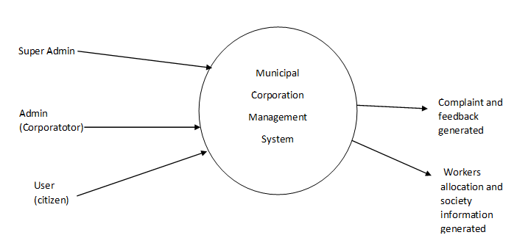
Data Flow Diagram (Level 0)

Slide 12
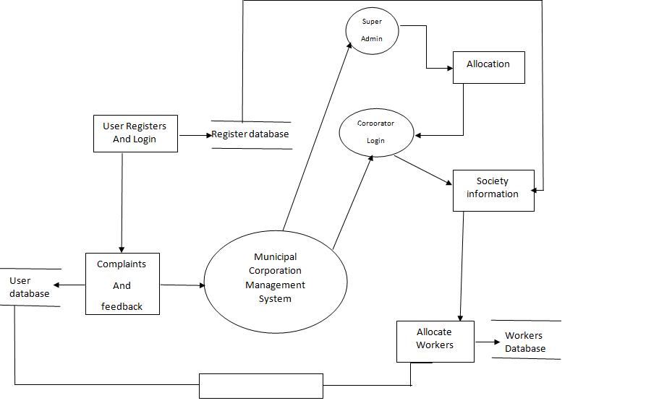
Dataflow Diagram (Level 1)
Feedback

Slide 13
Advantages
Time Efficient.
Reachable in remote areas.
Ease of problem sharing.
Getting proper feedback.

Slide 14
Disadvantages
Need of an internet connection.
Android based device the app access.

Slide 15
Conclusion
We proposed and introduced a mobile application for citizens to register complaints against the problems they are facing which can be solved by municipal corporation as nowadays android phones are much used by peoples so we created an app which can be used to lodge complaint in a very simple way by uploading a picture of suspected place.
The system proposed by us also has a web portal which provide user interface to citizens to lodge complaint and also make helps municipal corporation officers to solve the complaints easily by simplifying the process of forwarding complaint to admin of particular area. This system also provides employee a facility to update the status of the complaint about processing of the complaint which the lodger of the complaint can view using the id. The privilege is assigned to the admin but with the reason. It also has a module which generate status of the complaint.

Slide 16
References
Books :-
1.Building the Android Wiley Edition.
2.Getting Started with Android by Andrew Tross.
Websites :-
1.www.androidgeek.com
2.www.kolhapur municipalcorporation.com
3.nevonprojects.com

Slide 17
Thank You !!

